Slide 1
Cluster Analysis: Basic Concepts and Algorithms
Subhadip Basu

Slide 2
What is Cluster Analysis?
Finding groups of objects such that the objects in a group will be similar (or related) to one another and different from (or unrelated to) the objects in other groups
Inter-cluster distances are maximized
Intra-cluster distances are minimized

Slide 3
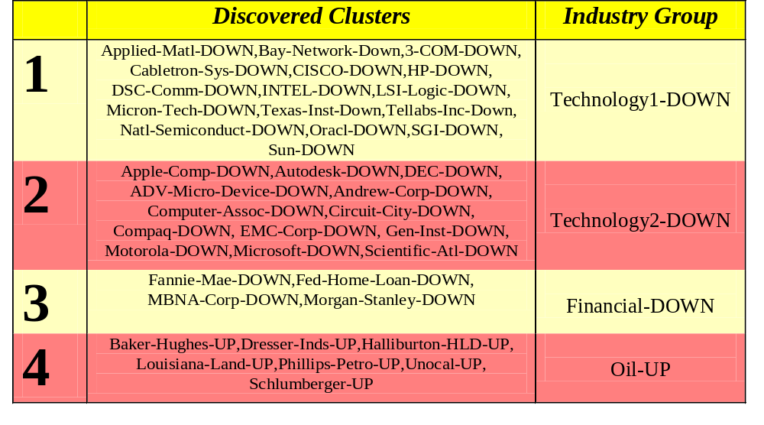
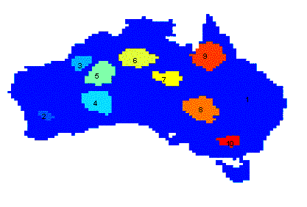
Applications of Cluster Analysis
Understanding
  Group related documents for browsing, group genes and proteins that have similar functionality, or group stocks with similar price fluctuations
Summarization
  Reduce the size of large data sets
Clustering precipitation in Australia

Slide 4
Notion of a Cluster can be Ambiguous
How many clusters?
Six Clusters
Two Clusters
Four Clusters

Slide 5
Types of Clusterings
A clustering is a set of clusters
Important distinction between hierarchical and partitional sets of clusters
Partitional Clustering
  A division data objects into non-overlapping subsets (clusters) such that each data object is in exactly one subset
Hierarchical clustering
  A set of nested clusters organized as a hierarchical tree

Slide 6

Partitional Clustering
Original Points
A Partitional Clustering

Slide 7
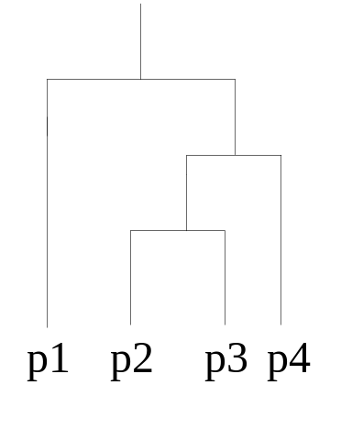
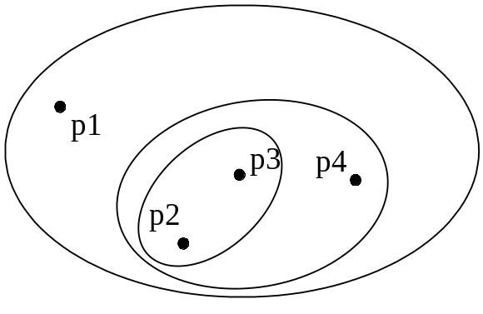
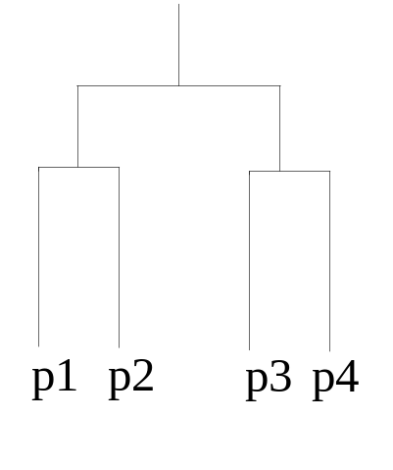
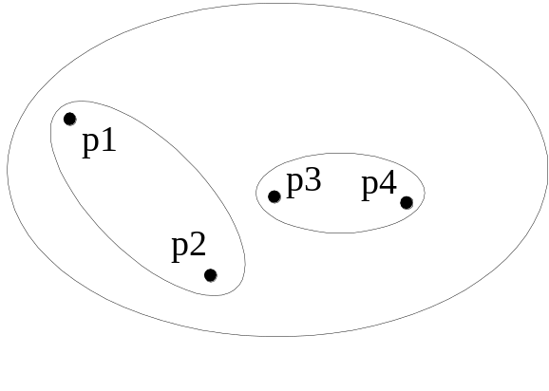
Hierarchical Clustering
Traditional Hierarchical Clustering
Traditional Dendrogram
Non-traditional Hierarchical Clustering
Non-traditional Dendrogram

Slide 8
Other Distinctions Between Sets of Clusters
Exclusive versus non-exclusive
  In non-exclusive clusterings, points may belong to multiple clusters.
  Can represent multiple classes or ‘border’ points
Fuzzy versus non-fuzzy
  In fuzzy clustering, a point belongs to every cluster with some weight between 0 and 1
  Weights must sum to 1
  Probabilistic clustering has similar characteristics
Partial versus complete
  In some cases, we only want to cluster some of the data
Heterogeneous versus homogeneous
  Cluster of widely different sizes, shapes, and densities

Slide 9
Types of Clusters: Well-Separated
Well-Separated Clusters:
  A cluster is a set of points such that any point in a cluster is closer (or more similar) to every other point in the cluster than to any point not in the cluster.
3 well-separated clusters

Slide 10
Types of Clusters: Center-Based
Center-based
  A cluster is a set of objects such that an object in a cluster is closer (more similar) to the “center” of a cluster, than to the center of any other cluster
  The center of a cluster is often a centroid, the average of all the points in the cluster, or a medoid, the most “representative” point of a cluster
4 center-based clusters

Slide 11
Types of Clusters: Contiguity-Based
Contiguous Cluster (Nearest neighbor or Transitive)
  A cluster is a set of points such that a point in a cluster is closer (or more similar) to one or more other points in the cluster than to any point not in the cluster.
8 contiguous clusters

Slide 12
Types of Clusters: Density-Based
Density-based
  A cluster is a dense region of points, which is separated by low-density regions, from other regions of high density.
  Used when the clusters are irregular or intertwined, and when noise and outliers are present.
6 density-based clusters

Slide 13
Types of Clusters: Conceptual Clusters
Shared Property or Conceptual Clusters
  Finds clusters that share some common property or represent a particular concept.
  .
2 Overlapping Circles

Slide 14
Types of Clusters: Objective Function
Clusters Defined by an Objective Function
  Finds clusters that minimize or maximize an objective function.
  Enumerate all possible ways of dividing the points into clusters and evaluate the `goodness' of each potential set of clusters by using the given objective function.
  Can have global or local objectives.
    Hierarchical clustering algorithms typically have local objectives
    Partitional algorithms typically have global objectives

Slide 15
Clustering Algorithms
K-means and its variants
Hierarchical clustering and its variants
Many more …

Slide 16

K-means Clustering
Partitional clustering approach
Each cluster is associated with a centroid (center point)
Each point is assigned to the cluster with the closest centroid
Number of clusters, K, must be specified
The basic algorithm is very simple

Slide 17
K-means Clustering – Details
Initial centroids are often chosen randomly.
  Clusters produced vary from one run to another.
The centroid is (typically) the mean of the points in the cluster.
‘Closeness’ is measured by Euclidean distance, cosine similarity, correlation, etc.
K-means will converge for common similarity measures mentioned above.
Most of the convergence happens in the first few iterations.
  Often the stopping condition is changed to ‘Until relatively few points change clusters’
Complexity is O( n * K * I * d )
  n = number of points, K = number of clusters,
  I = number of iterations, d = number of attributes

Slide 18



Two different K-means Clusterings
Original Points
Optimal Clustering
Sub-optimal Clustering

Slide 19






Importance of Choosing Initial Centroids

Slide 20
Importance of Choosing Initial Centroids

Slide 21
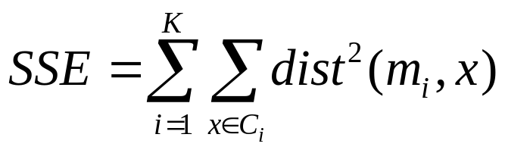
Evaluating K-means Clusters
Most common measure is Sum of Squared Error (SSE)
  For each point, the error is the distance to the nearest cluster
  To get SSE, we square these errors and sum them.
  x is a data point in cluster C_{i} and m_{i} is the representative point for cluster C_{i}
    can show that m_{i} corresponds to the center (mean) of the cluster
  Given two clusters, we can choose the one with the smallest error
  One easy way to reduce SSE is to increase K, the number of clusters
    A good clustering with smaller K can have a lower SSE than a poor clustering with higher K

Slide 22
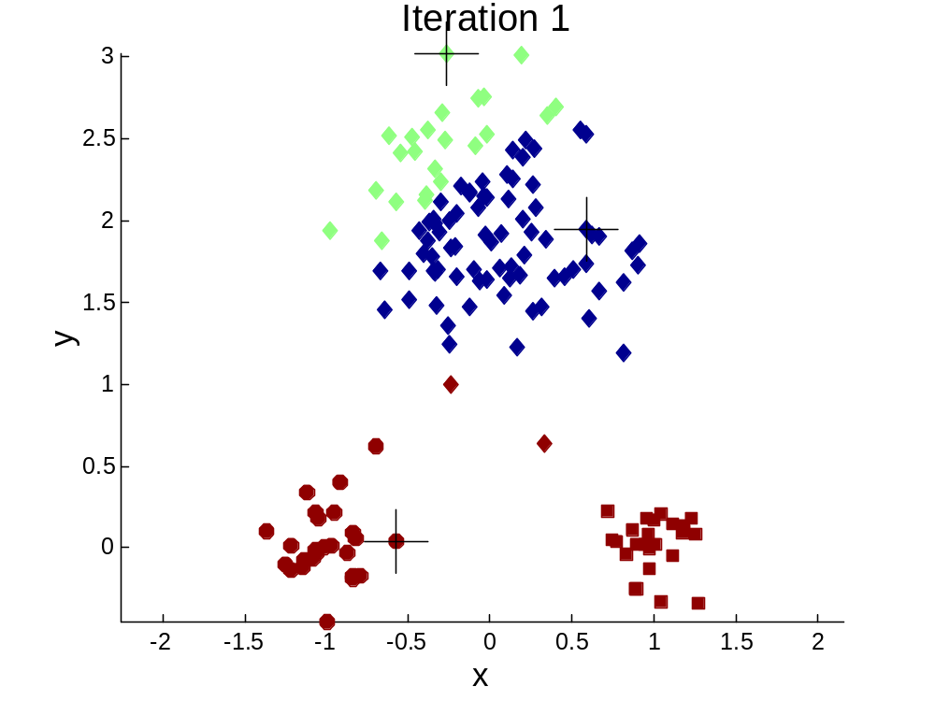


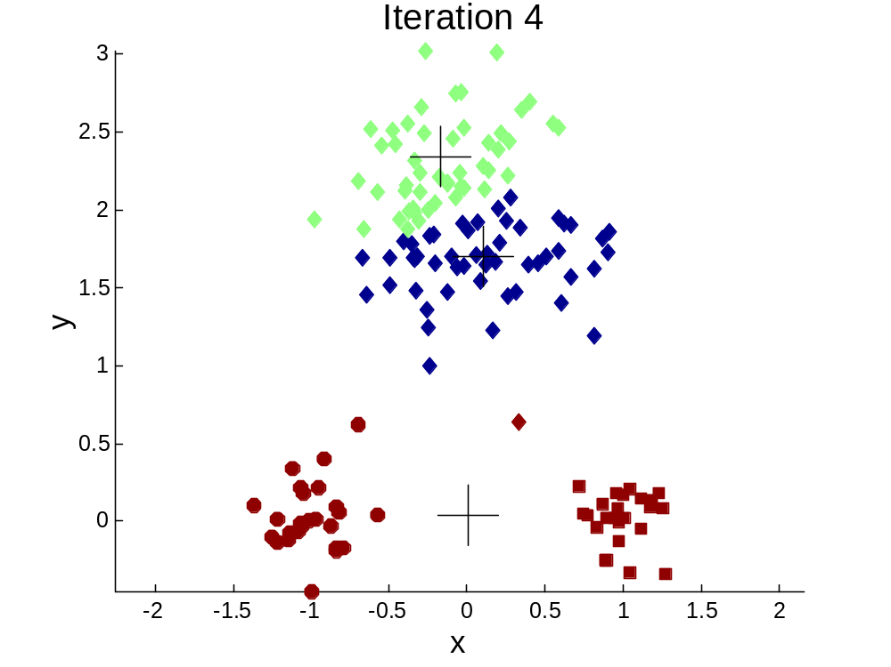
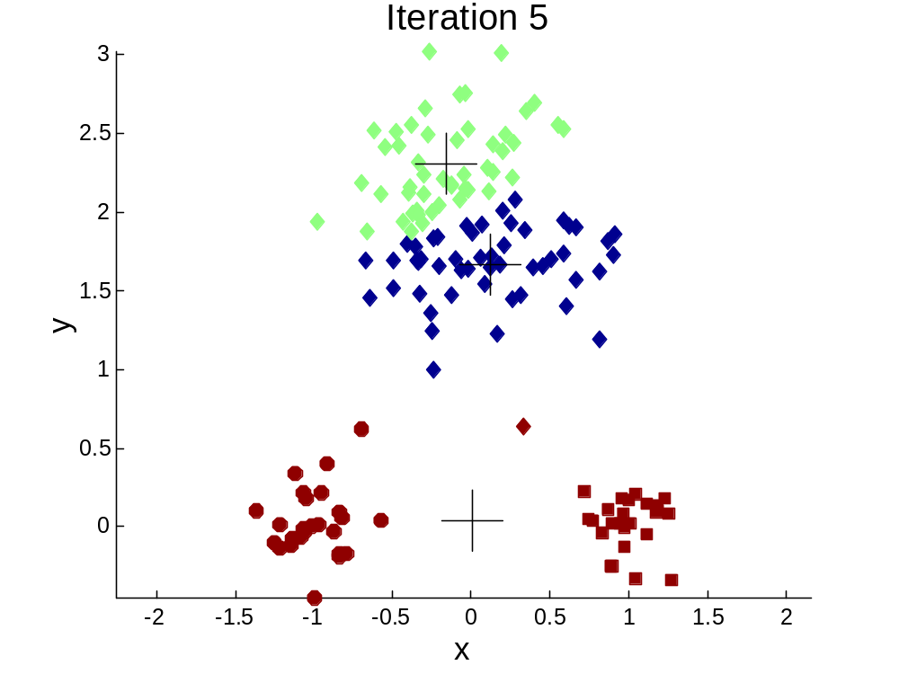
Importance of Choosing Initial Centroids …

Slide 23
Importance of Choosing Initial Centroids …

Slide 24
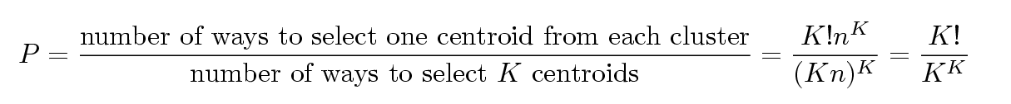
Problems with Selecting Initial Points
If there are K ‘real’ clusters then the chance of selecting one centroid from each cluster is small.
  Chance is relatively small when K is large
  If clusters are the same size, n, then
  For example, if K = 10, then probability = 10!/10¹⁰ = 0.00036
  Sometimes the initial centroids will readjust themselves in ‘right’ way, and sometimes they don’t
  Consider an example of five pairs of clusters

Slide 25
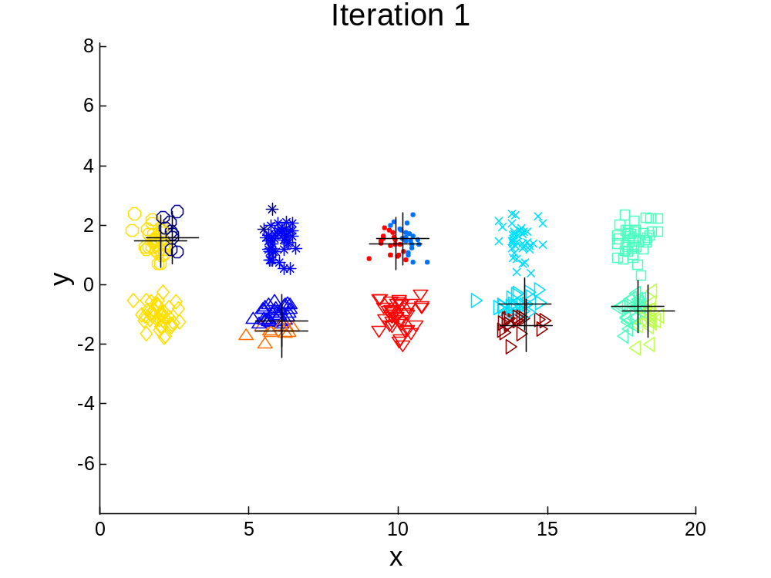
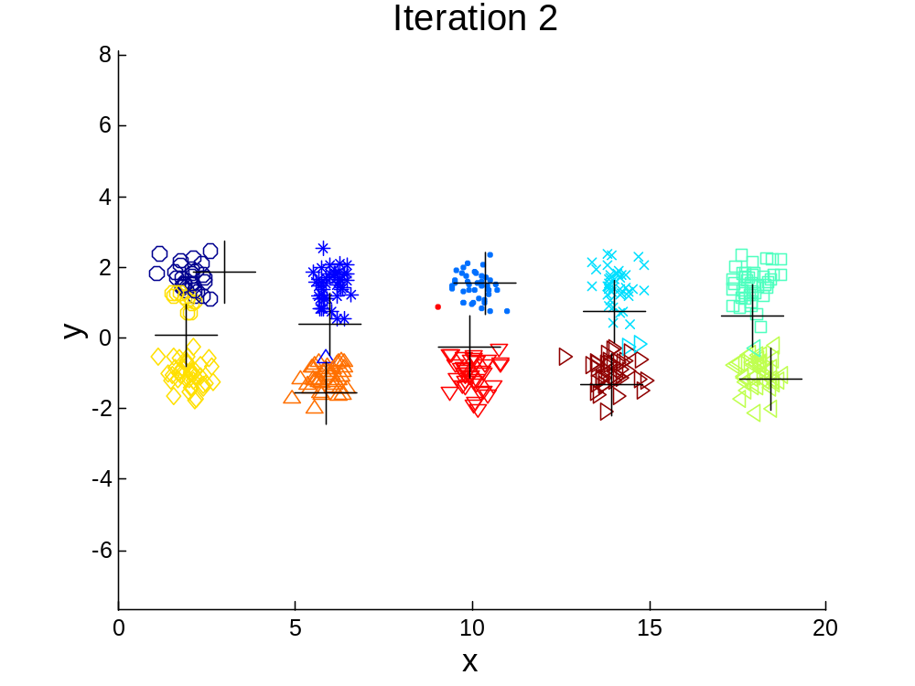
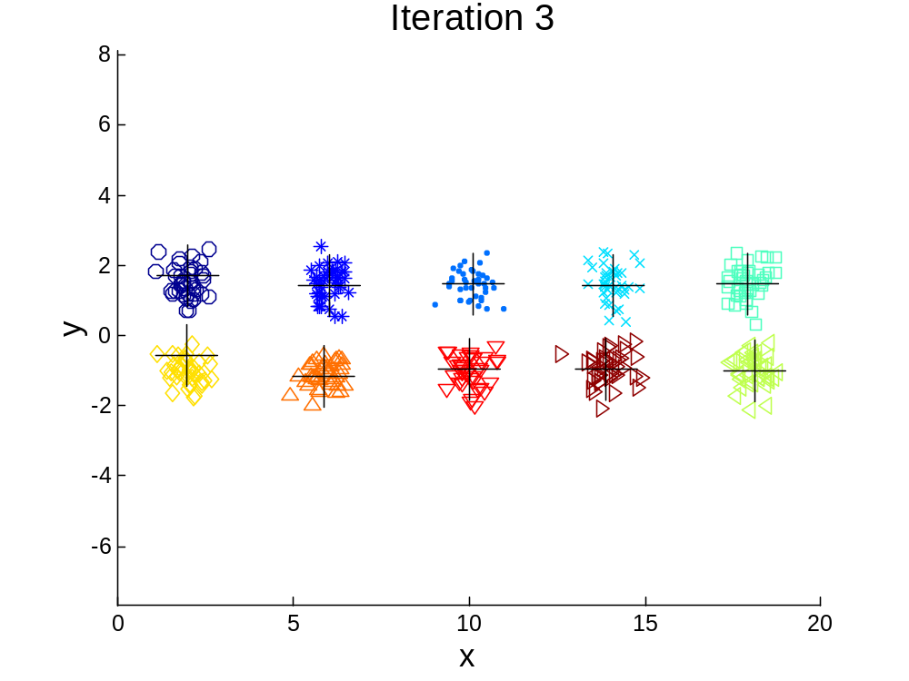

10 Clusters Example
Starting with two initial centroids in one cluster of each pair of clusters

Slide 26
10 Clusters Example
Starting with two initial centroids in one cluster of each pair of clusters

Slide 27
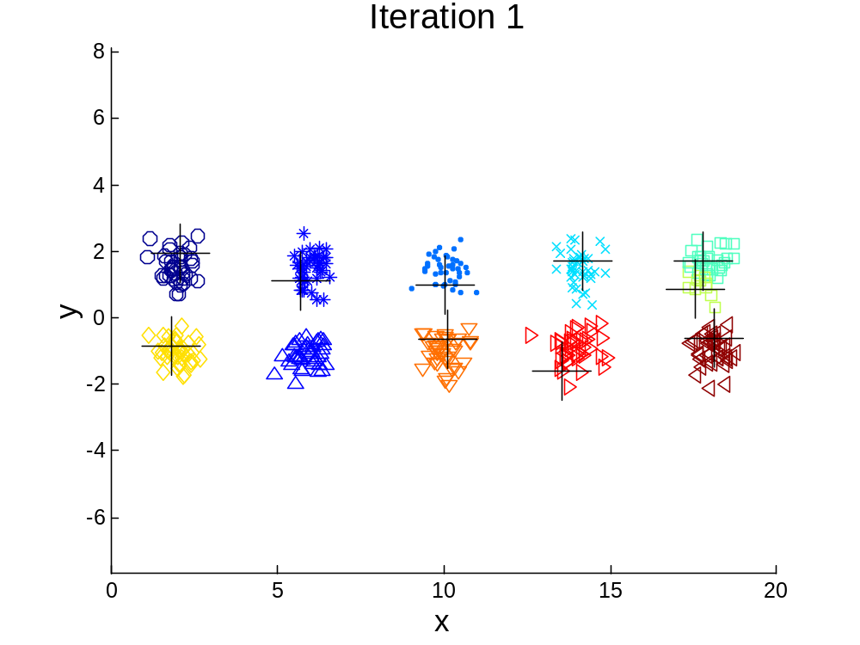



10 Clusters Example
Starting with some pairs of clusters having three initial centroids, while other have only one.

Slide 28
10 Clusters Example
Starting with some pairs of clusters having three initial centroids, while other have only one.

Slide 29
Solutions to Initial Centroids Problem
Multiple runs
  Helps, but probability is not on your side
Sample and use hierarchical clustering to determine initial centroids
Bisecting K-means
  Not as susceptible to initialization issues

Slide 30

Bisecting K-means
Bisecting K-means algorithm
  Variant of K-means that can produce a partitional or a hierarchical clustering

Slide 31
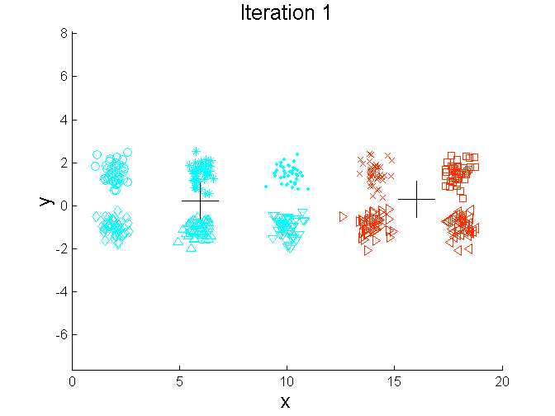
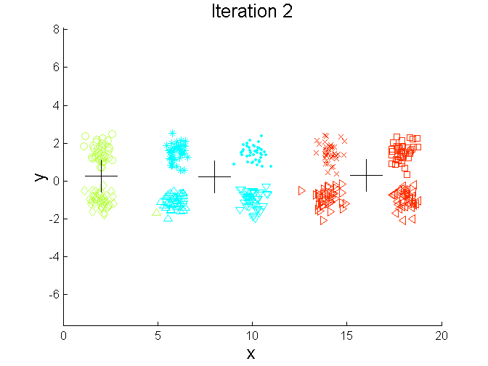
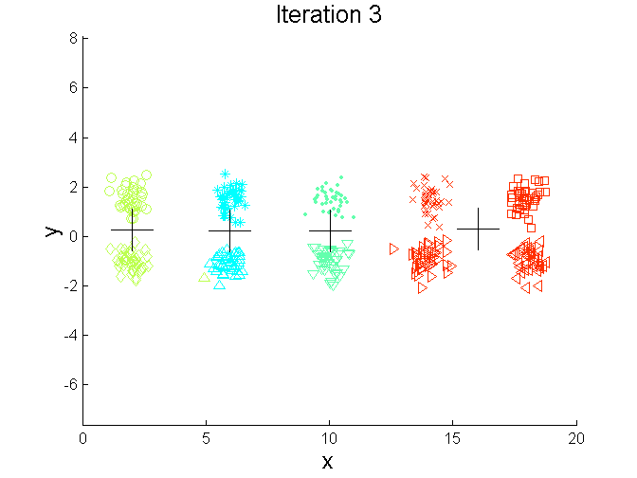
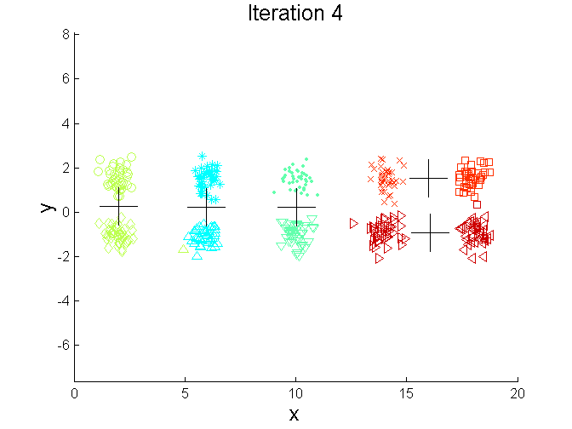
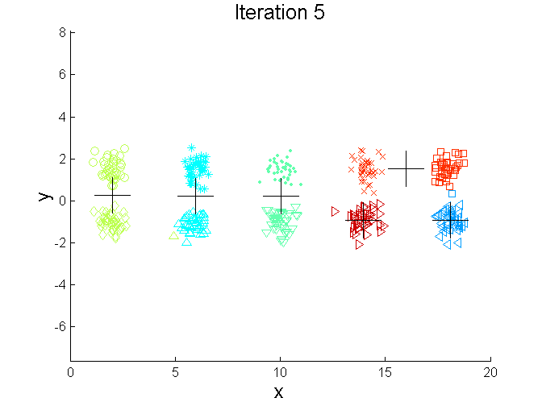
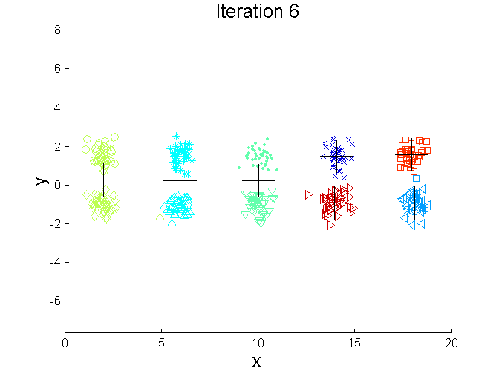
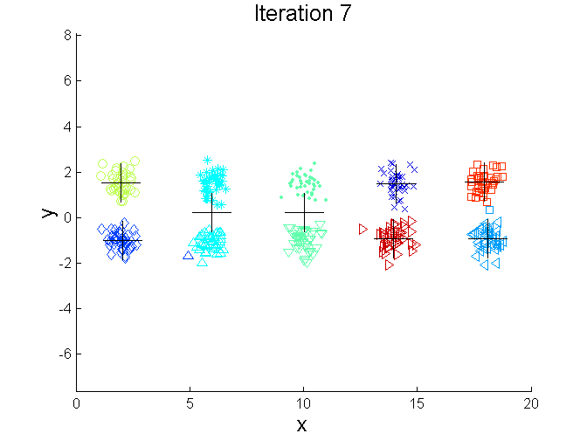
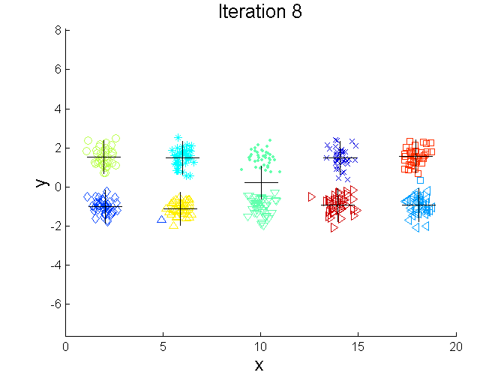
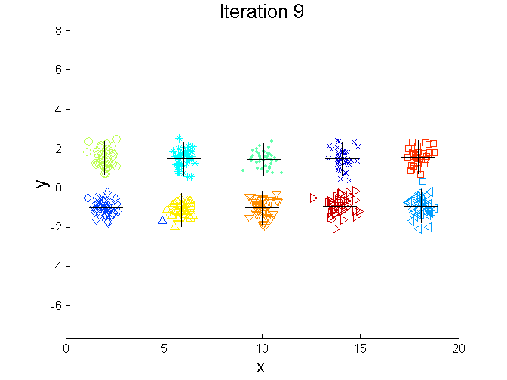
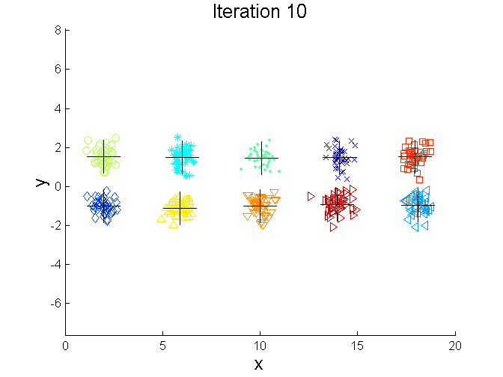
Bisecting K-means Example

Slide 32
Limitations of K-means
K-means has problems when clusters are of differing
  Sizes
  Densities
  Non-globular shapes
K-means has problems when the data contains outliers.

Slide 33


Limitations of K-means: Differing Sizes
Original Points
K-means (3 Clusters)

Slide 34


Limitations of K-means: Differing Density
Original Points
K-means (3 Clusters)

Slide 35


Limitations of K-means: Non-globular Shapes
Original Points
K-means (2 Clusters)

Slide 36

Overcoming K-means Limitations
Original Points K-means Clusters
One solution is to use many clusters.
  Find parts of clusters, but need to put together.

Slide 37
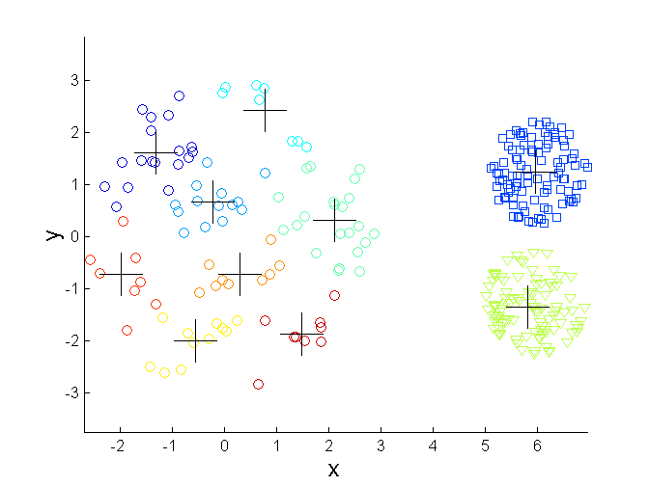
Overcoming K-means Limitations
Original Points K-means Clusters

Slide 38
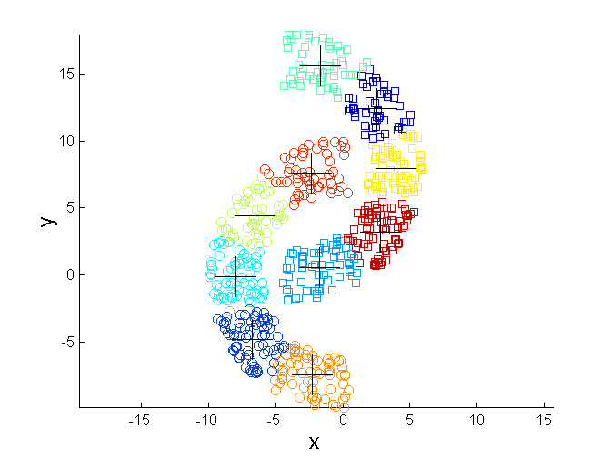
Overcoming K-means Limitations
Original Points K-means Clusters

Slide 39


Hierarchical Clustering
Produces a set of nested clusters organized as a hierarchical tree
Can be visualized as a dendrogram
  A tree like diagram that records the sequences of merges or splits

Slide 40
Strengths of Hierarchical Clustering
Do not have to assume any particular number of clusters
  Any desired number of clusters can be obtained by ‘cutting’ the dendogram at the proper level
They may correspond to meaningful taxonomies
  Example in biological sciences (e.g., animal kingdom, phylogeny reconstruction, …)

Slide 41
Hierarchical Clustering
Two main types of hierarchical clustering
  Agglomerative:
    Start with the points as individual clusters
    At each step, merge the closest pair of clusters until only one cluster (or k clusters) left
  Divisive:
    Start with one, all-inclusive cluster
    At each step, split a cluster until each cluster contains a point (or there are k clusters)
Traditional hierarchical algorithms use a similarity or distance matrix
  Merge or split one cluster at a time

Slide 42
Agglomerative Clustering Algorithm
More popular hierarchical clustering technique
Basic algorithm is straightforward
  Compute the proximity matrix
  Let each data point be a cluster
  Repeat
  Merge the two closest clusters
  Update the proximity matrix
  Until only a single cluster remains
Key operation is the computation of the proximity of two clusters
  Different approaches to defining the distance between clusters distinguish the different algorithms

Slide 43
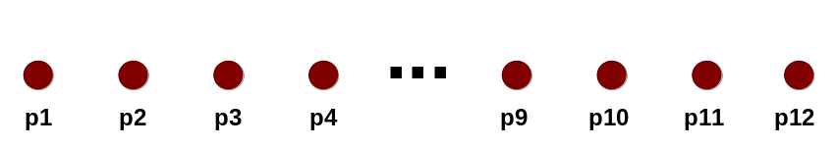
Starting Situation
Start with clusters of individual points and a proximity matrix
p1
p2
p3
p4
p5
. . .
p1
p2
p3
p4
p5
.
.
.
Proximity Matrix

Slide 44
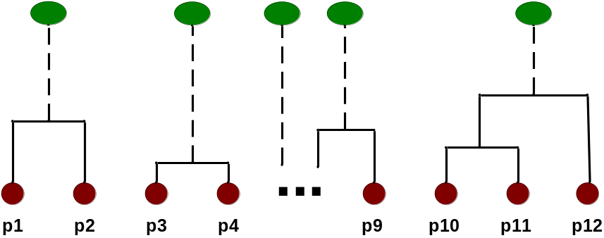
Intermediate Situation
After some merging steps, we have some clusters
C1
C2
C3
C4
C5
C1
C2
C3
C3
C4
C4
C5
Proximity Matrix
C1
C2
C5

Slide 45

Intermediate Situation
We want to merge the two closest clusters (C2 and C5) and update the proximity matrix.
C1
C2
C3
C4
C5
C1
C2
C3
C3
C4
C4
C5
Proximity Matrix
C1
C2
C5

Slide 46

After Merging
The question is “How do we update the proximity matrix?”
C2 U C5
C1
C3
C4
C1
?
C2 U C5
? ? ? ?
C3
C3
?
C4
C4
?
Proximity Matrix
C1
C2 U C5

Slide 47
How to Define Inter-Cluster Similarity
p1
p2
p3
p4
p5
. . .
p1
Similarity?
p2
p3
p4
p5
MIN
MAX
Group Average
Distance Between Centroids
Other methods driven by an objective function
  Ward’s Method uses squared error
.
.
.
Proximity Matrix

Slide 48
How to Define Inter-Cluster Similarity
p1
p2
p3
p4
p5
. . .
p1
p2
p3
p4
p5
MIN
MAX
Group Average
Distance Between Centroids
Other methods driven by an objective function
  Ward’s Method uses squared error
.
.
.
Proximity Matrix

Slide 49
How to Define Inter-Cluster Similarity
p1
p2
p3
p4
p5
. . .
p1
p2
p3
p4
p5
MIN
MAX
Group Average
Distance Between Centroids
Other methods driven by an objective function
  Ward’s Method uses squared error
.
.
.
Proximity Matrix

Slide 50
How to Define Inter-Cluster Similarity
p1
p2
p3
p4
p5
. . .
p1
p2
p3
p4
p5
MIN
MAX
Group Average
Distance Between Centroids
Other methods driven by an objective function
  Ward’s Method uses squared error
.
.
.
Proximity Matrix

Slide 51
How to Define Inter-Cluster Similarity
p1
p2
p3
p4
p5
. . .
p1
×
×
p2
p3
p4
p5
MIN
MAX
Group Average
Distance Between Centroids
Other methods driven by an objective function
  Ward’s Method uses squared error
.
.
.
Proximity Matrix

Slide 52

Hierarchical Clustering: MIN
5
1
3
5
2
1
2
3
6
4
4
Nested Clusters
Dendrogram

Slide 53

Cluster Similarity: MAX or Complete Linkage
Similarity of two clusters is based on the two least similar (most distant) points in the different clusters
  Determined by all pairs of points in the two clusters
1
2
3
4
5

Slide 54
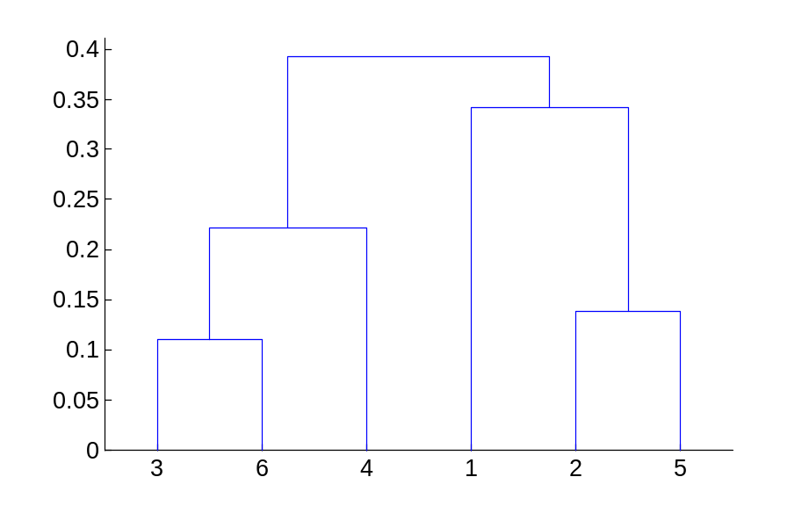
Hierarchical Clustering: MAX
4
1
2
5
5
2
3
6
3
1
4
Nested Clusters
Dendrogram

Slide 55
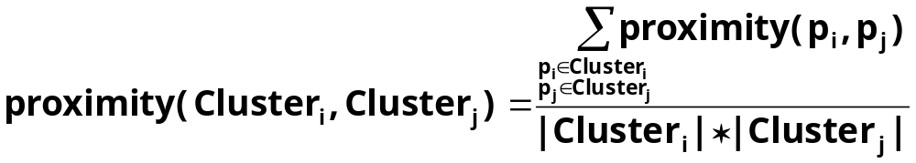

Cluster Similarity: Group Average
Proximity of two clusters is the average of pairwise proximity between points in the two clusters.
Need to use average connectivity for scalability since total proximity favors large clusters
1
2
3
4
5

Slide 56

Hierarchical Clustering: Group Average
5
4
1
2
5
2
3
6
1
4
3
Nested Clusters
Dendrogram

Slide 57
Hierarchical Clustering: Group Average
Compromise between Single and Complete Link
Strengths
  Less susceptible to noise and outliers
Limitations
  Biased towards globular clusters

Slide 58
Hierarchical Clustering: Time and Space requirements
O(N²) space since it uses the proximity matrix.
  N is the number of points.
O(N³) time in many cases
  There are N steps and at each step the size, N², proximity matrix must be updated and searched
  Complexity can be reduced to O(N² log(N) ) time for some approaches

Slide 59
Hierarchical Clustering: Problems and Limitations
Once a decision is made to combine two clusters, it cannot be undone
No objective function is directly minimized
Different schemes have problems with one or more of the following:
  Sensitivity to noise and outliers
  Difficulty handling different sized clusters and convex shapes
  Breaking large clusters

Slide 60
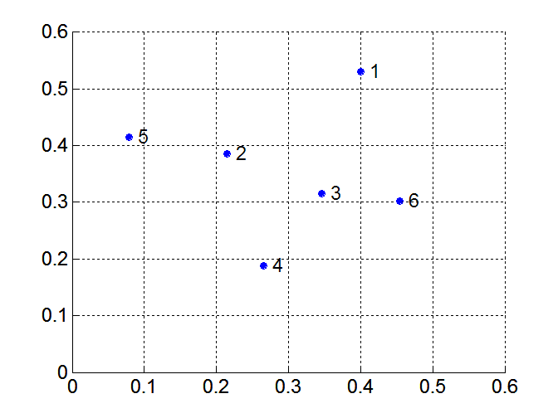
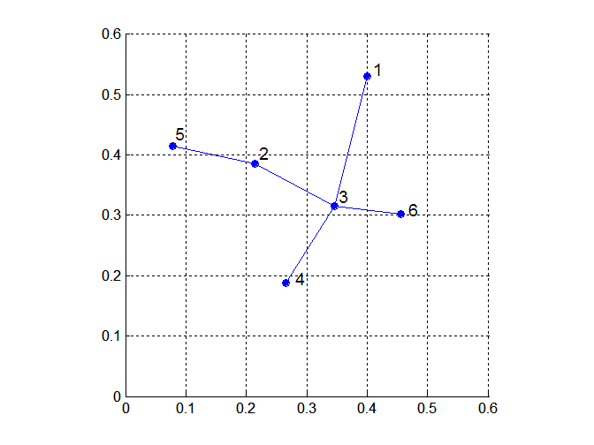
MST: Divisive Hierarchical Clustering
Build MST (Minimum Spanning Tree)
  Start with a tree that consists of any point
  In successive steps, look for the closest pair of points (p, q) such that one point (p) is in the current tree but the other (q) is not
  Add q to the tree and put an edge between p and q

Slide 61
DBSCAN
DBSCAN is a density-based algorithm.
  Density = number of points within a specified radius (Eps)
  A point is a core point if it has more than a specified number of points (MinPts) within Eps
    These are points that are at the interior of a cluster
  A border point has fewer than MinPts within Eps, but is in the neighborhood of a core point
  A noise point is any point that is not a core point or a border point.

